Slide 1

University Cafe Inter-Connection Mobile Application
Final Year Project 2022
Submitted By
Muhammad Sharjeel Dar 18321519-129
Umair Arif 18321519-141
Muhammad Touseef Ul Hassan 18321519-146
Supervised By
Dr. Touqeer Ehsan

Slide 2

Introduction
Overview
Statement of the Problem
Goal & Objectives
Architecture Diagram
Data Flow Diagram
High Level System Component
Tools and Technologies
Feature/Scope of the App
Results

Slide 3

Introduction
The University Cafe Inter-Connection Mobile Application is an android application.
This app will help buyers place orders by using the mobile application.
The main functionality of this application is that buyers can place an order by using this system and either can deliver the order to their destination.
The purpose of working on this project is to provide an ease to employees and students so that they can order anything, anytime while sitting anywhere and it can change the food ordering system into a better and appropriate way.

Slide 4
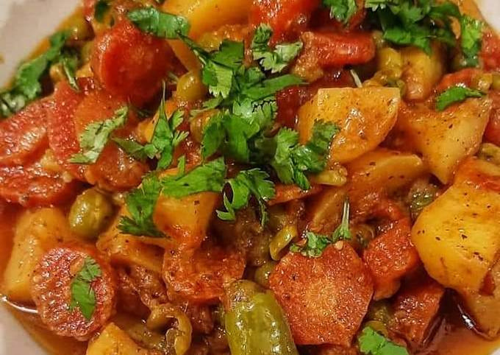

Problem Statement
Why we are building this project?
The problem statement is correctly formulated as we will develop an app that is surely able to place orders from the desired cafe.
We make this Mobile Application (University Cafe Inter-Connection Mobile Application) for University.
By using this App, an employee can easily access all the things that belong to a cafe while sitting anywhere instead of going to a cafe and avoid facing a rush which is a very major problem in a cafe the time is wasted too in ordering food while preparing the order, it took a lot of time.
The prices of items on the menu will be supervised by the admin office.

Slide 5

Goal & Objectives
Goal:
The main goal of our project is to facilitate the university employee and monitor the rate of university cafe’s menu.
Objectives:
Menus of desired can be checked by the User (Employee).
Order can be placed through this mobile application.
The application will be user-friendly.
Feedback could be submitted by the user through the application.
The customer/User will receive his order on time.
The application will be efficient.
The prices of items on the menu will be supervised by the admin office.

Slide 6
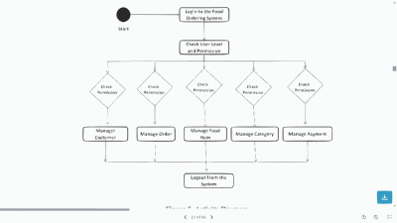
Architecture Diagram

Slide 7
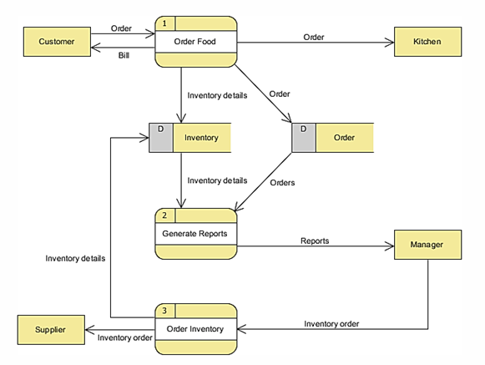
Data Flow Diagram

Slide 8
High Level System Component
User Management | Sign up and Login module for users in which they will get access to menu list as well as for the seller where they will receive the notifications of recent order Placement.
Company/Cafe’s Management | The list of cafes and their data should be managed through the application. We'll also manage the cafe’s rate list through the application as per the university rate list.
Shop/Cafe Selection | Users can select a shop/cafe of their own choice and can see the menu what they offer and can place an order according to their own choice.
Notification Management: | The user will be notified after placing the order and the seller will also be notified of recent order placement.
Order Management: | We will keep a record of all orders that will be received through an application.
Order Recommendation: | Order will recommend to the user on the basis of the most frequent order history using machine learning algorithms.

Slide 9
Tools and Technologies
Visual Studio Code
The main tool for developing an App
Android Studio
The main tool for developing apps as well as we use it as an emulator device
Flutter
For creating the User Interface
MySQL
For creating database
Microsoft Visio
For project designing (Prototyping)
Adobe Photoshop
For editing photos and designing
Canva
For LOGO designing
MS Office
For Documentation
Languages
Dart, Flutter, MySQL, Laravel

Slide 10
Native Android Application
Classified Products
Easy add to cart with one click item
User Management
Company/Cafe’s Management
User Menu
Manage Orders
Shop/Cafe Selection
Notification Management
Order Management
Order Recommendation
Feature/Scope of the App

Slide 11
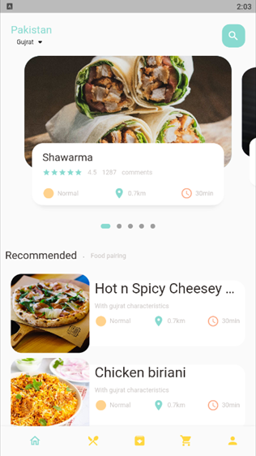
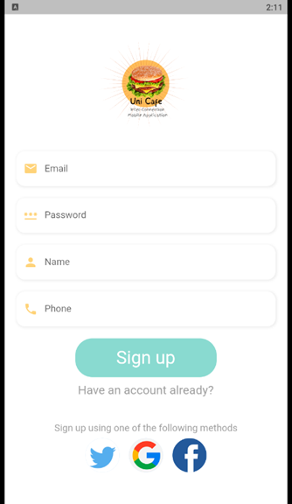
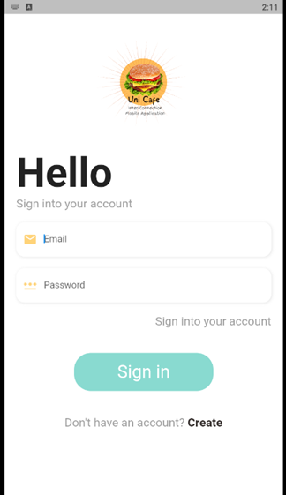
Results
Home Page
Sign Up Page
Sign In Page
Home page displays food category.to
Sign up using your credential.
Sign in based on your email.

Slide 12
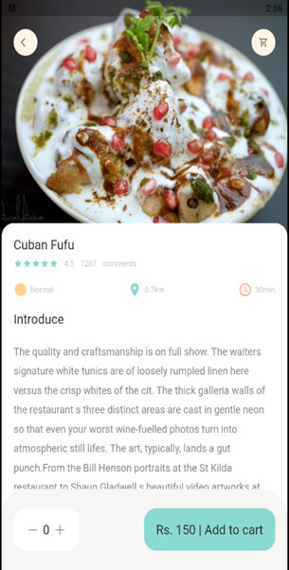
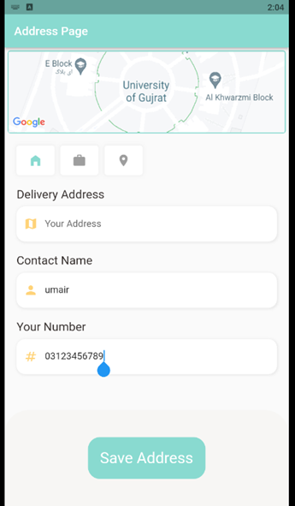
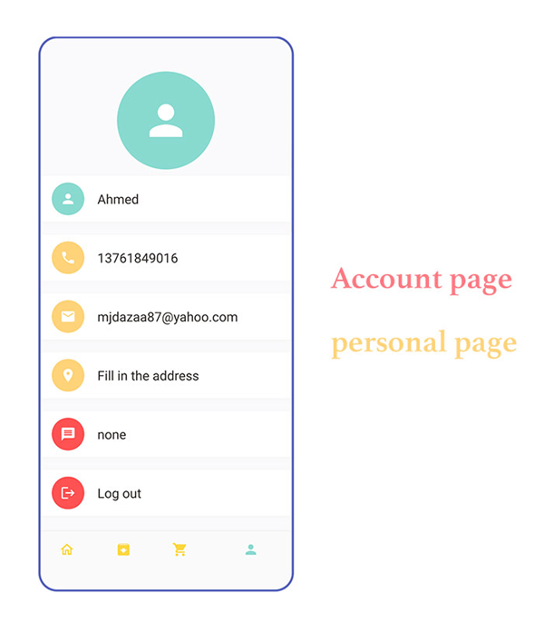
Results (cont.)
Recommended food page
Update Address Page
Account page
This page comes from the home page and you can add the item to the cart
You can update your address here.
Your personal information is here.

Slide 13
Thanks
Thank you for listening!

